Slide 1

Natural Language Processing
Session 1
HARUG! 2023-01-18
Ed Harris

Slide 2


https://github.com/aws-samples/aws-machine-learning-university-accelerated-nlp
https://www.youtube.com/channel/UC12LqyqTQYbXatYS9AA7Nuw

Slide 3
Introduction to Natural Language Processing (NLP)
Notes:
All looked/worked great with our toy dataset, but real life data – that’s another (long) story
how much data: more data samples, more features
what type of data: numerical, categorical, text (not all numbers ?!)
missing values
different scales (large/small) numerical values
outliers

Slide 4
Some NLP Terms
Corpus: Large collection of words or phrases - can come from different sources: documents, web sources, database
Common Crawl Corpus: web crawl data composed of over 5 billion web pages (541 TB)
Reddit Submission Corpus: publicly available Reddit submissions (42 GB)
Wikipedia XML Data: complete copy of all Wikimedia wikis, in the form of wikitext source and metadata embedded in XML. (500 GB)
Etc.

Slide 5
Some NLP Terms
every
bike
electric
party
salad
early
next
come
work
like
part
sense
always
word
hard
doctor
tool
turn
time
code
me
land
time
smart
home
line
ball
soft
pay
science
piece
none
comedy
term
foot
late
debt
lane
cake
go
dress
sense
sun
phone
cook
balance
cold
call
he
tech
equal
Token: Words or phrases extracted from documents
Feature vector: A numeric array that ML models use for different tasks such as training and prediction

Slide 6
Machine Learning with Text Data
Notes:
All looked/worked great with our toy dataset, but real life data – that’s another (long) story
how much data: more data samples, more features
what type of data: numerical, categorical, text (not all numbers ?!)
missing values
different scales (large/small) numerical values
outliers

Slide 7
Machine Learning with Text Data
ML models need well-defined numerical data.
Text data
Text preprocessing
(Cleaning and formatting)
Vectorization
(Convert to numbers)
Train ML Model using numerical data
Stop words removal,
Stemming, Lemmatization
Bag of Words
K Nearest Neighbors (KNN),
Neural Network, etc.

Slide 8
Text Pre-processing
Notes:
All looked/worked great with our toy dataset, but real life data – that’s another (long) story
how much data: more data samples, more features
what type of data: numerical, categorical, text (not all numbers ?!)
missing values
different scales (large/small) numerical values
outliers

Slide 9
Tokenization
Splits text/document into small parts by white space and punctuation.
Example:
These tokens will be used in the next steps in the pipeline.
Sentence | Tokens
“I don’t like eggs.” | “I”, “do”, “n’t”, “like”, “eggs”, “.”

Slide 10
Stop Words Removal
Stop words: Some words that frequently appear in texts, but they don’t contribute too much to the overall meaning.
Common stop words: “a”, “the”, “so”, “is”, “it”, “at”, “in”, “this”, “there”, “that”, “my”
Example:
Original sentence | Without stop words
“There is a tree near the house” | “tree near house”

Slide 11
Stop Words Removal
Stop words: Some words that frequently appear in texts, but they don’t contribute too much to the overall meaning.
Common stop words: “a”, “the”, “so”, “is”, “it”, “at”, “in”, “this”, “there”, “that”, “my”
Example:
Original sentence | Without stop words
“There is a tree near the house” | “tree near house”

Slide 12
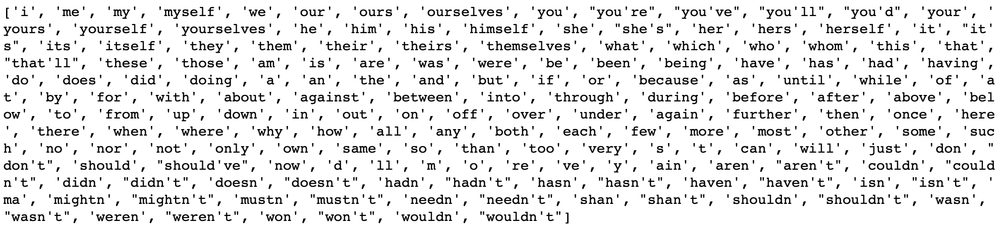
Stop Words Removal
Stop words from the Natural Language Tool Kit (NLTK)* library:
Assume, we have a text classification problem: A product review is positive or negative.
Is this a good stop words list for this problem?
* https://www.nltk.org/

Slide 13
Stop Words Removal
Stop words from the Natural Language Tool Kit (NLTK)* library:
Assume, we have a text classification problem: A product review is positive or negative.
Is this a good stop words list for this problem? NO
* https://www.nltk.org/

Slide 14
Stemming
Set of rules to slice a string to a substring that usually refers to a more general meaning.
The goal is to remove word affixes (particularly suffixes) such as “s”, “es”, “ing”, “ed”, etc.
“playing”
“played” “play”
”plays”
The issue: It doesn’t usually work with irregular forms such as irregular verbs: “taught”, “brought”, etc.

Slide 15
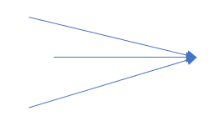
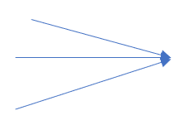
Lemmatization
Similar to stemming, but more advanced. It uses a look-up dictionary.
Handles more situations and usually works better than stemming.
“taught” -”am”
“teaching” “teach” -”is” “be”
“teaches” -“are”
For the best results, correct word position tags should be provided: “adjective”, “noun”, “verb” etc.

Slide 16
Stemming vs. Lemmatization
Summary: lemmatization is a more complex method and usually works better. E.g.,
Original sentence: "the children are playing outside. the weather was better yesterday."
Stemming => “the children are play outside. the weather was better yesterday”
Lemmatization => “the child be play outside. the weather be good yesterday”

Slide 17

Text Processing – Hands-on
Exercise:
Simple text cleaning processes
Stop words removal
Stemming, Lemmatization
MLA_NLP_EH1_Text_Process.ipynb

